Slide 1


Patient’s Unique Identification
Submitted By:
Abhinav Bhardwaj(181500009)
Aditya Singh Chauhan(181500046)
Anvit Gupta(181500127)
Notes:
Photo by Sean Pollock on Unsplash

Slide 2
Outline
INTRODUCTION
- Main Idea
- Major application area
BASIC COMPONENT USED IN THIS PROJECT
WORKING PROCESS
BASIC ANDROID APP FUNCTIONALITY
- Splash activity screen
- Sign in activity
- Sign Up activity
- Dashboard activity
- Upload Report activity
- BMI activity
- Profile activity
-PUI id activity
LIVE DEMO SESSION
CONCLUSION
Website poartal

Slide 3
Introduction
Main Idea Behind the Project:
In our society at present, patients used to keep hard copies of reports and prescriptions which are very difficult to maintain. There is no central system in our country that can access anyone's medical history in an accident or emergency. Provides accessibility. We depend entirely on the patient or his family during treatment resulting in problematic delays.
Our system will provide each patient with a unique identifier that can be used to view his or her past medical history. The system will monitor all records with appropriate update and modification facilities as per requirement. The patient will be able to enter their own database using the same username and password set during the signup process, also every patient can access, update and modify their own records through our system

Slide 4
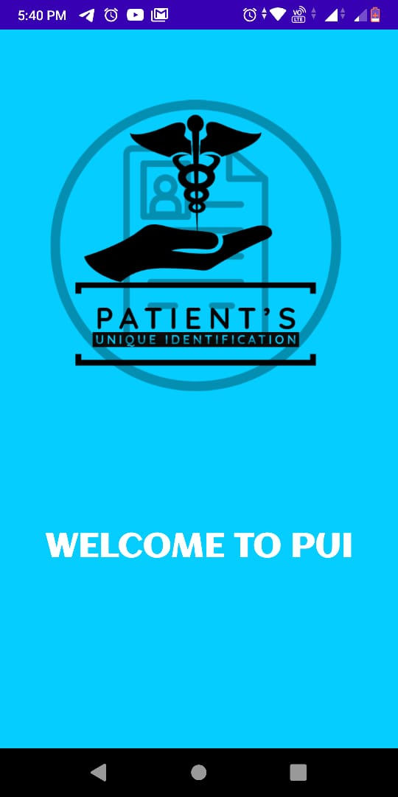
Major Application Area :
By any individual for handling document
By any paramedical staff

Slide 5
Basic Component used in this project:
Android Studio IDE: Used Linear , Relative and ScrollView layout and design through XML.
VS Code: It is a code editor redefined and optimized for building and debugging modern web and cloud applications.
Java Programming language: It is used to program the functionality of every view
MERN Stack:MERN is one of several variations of the
MEAN stack (MongoDB Express Angular Node), where the
traditional Angular.js frontend framework is replaced
with React.js.

Slide 6
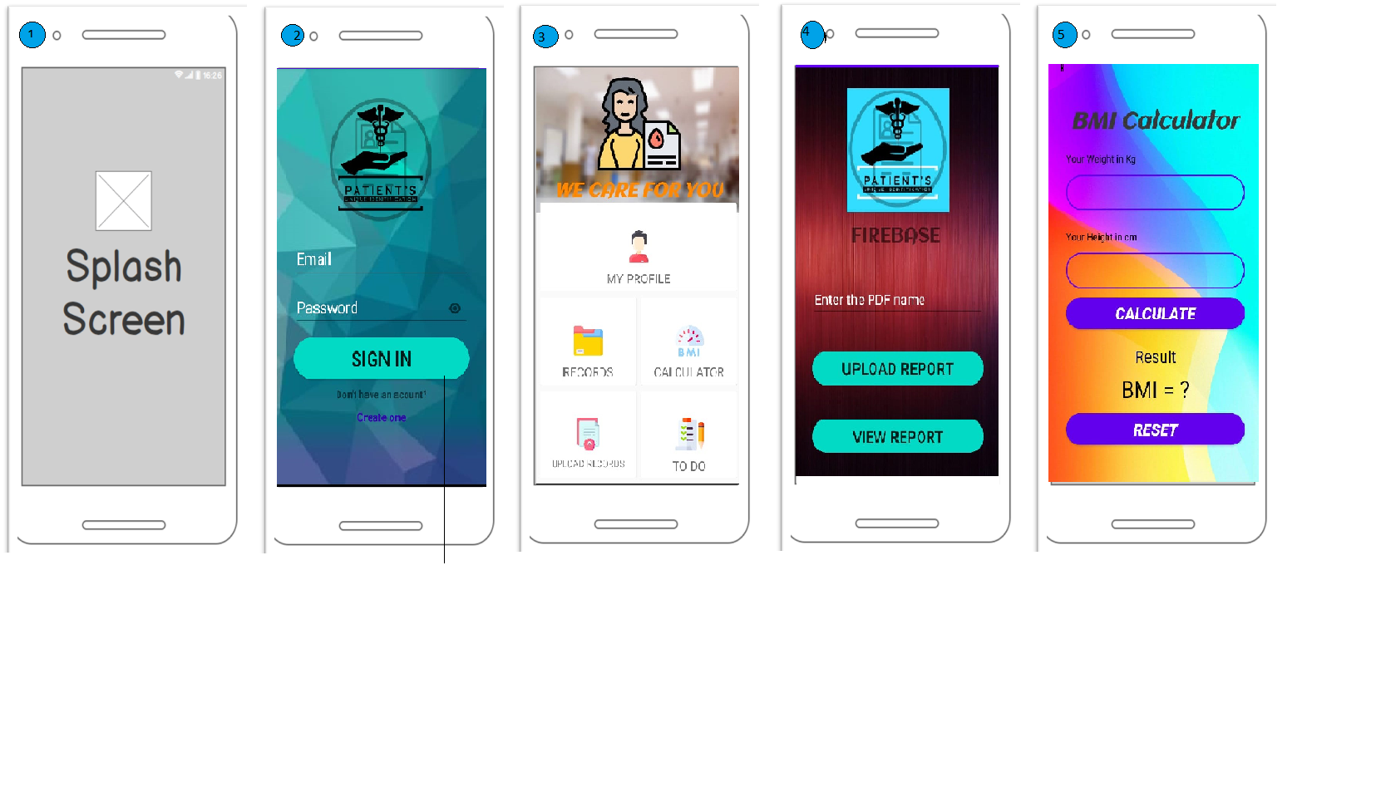
Working Process

Slide 7
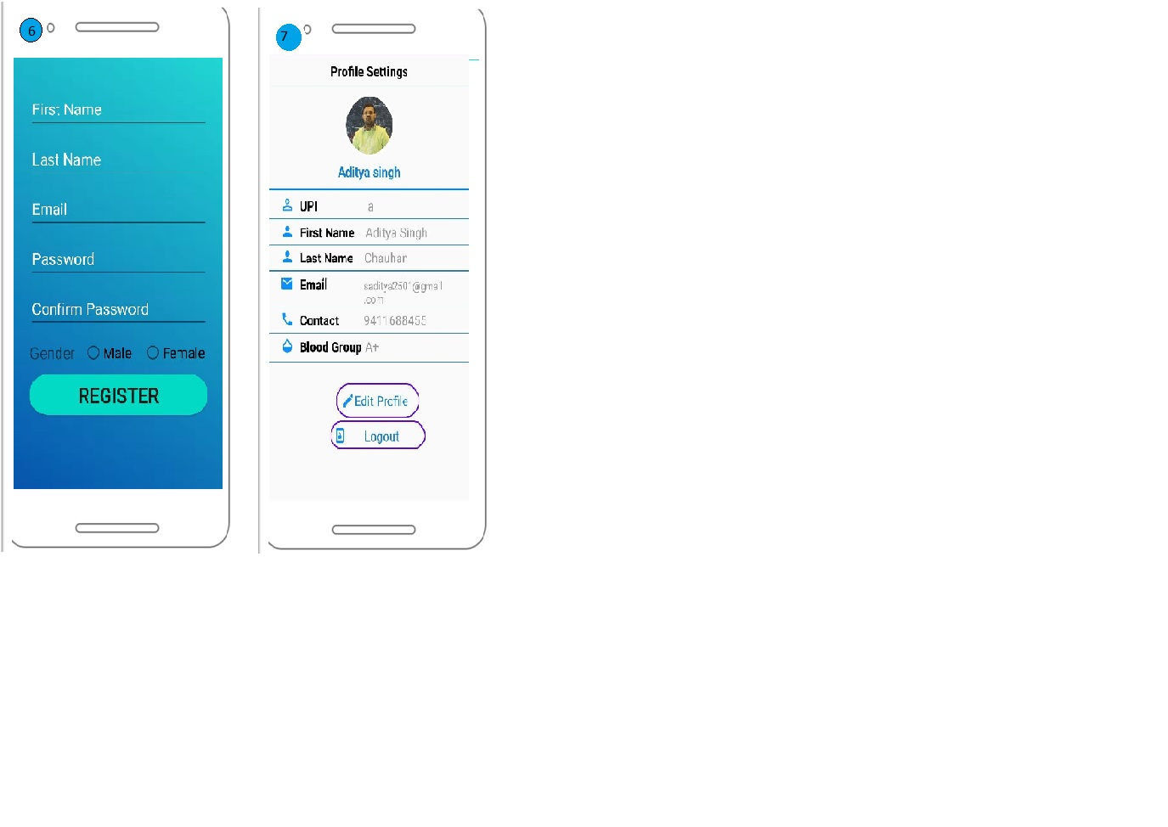
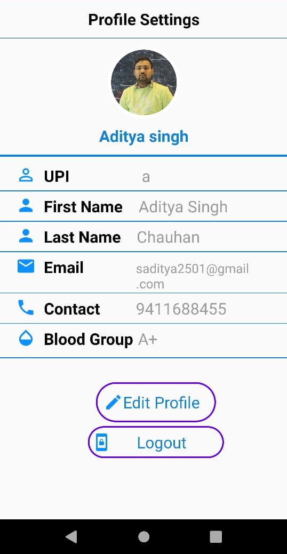
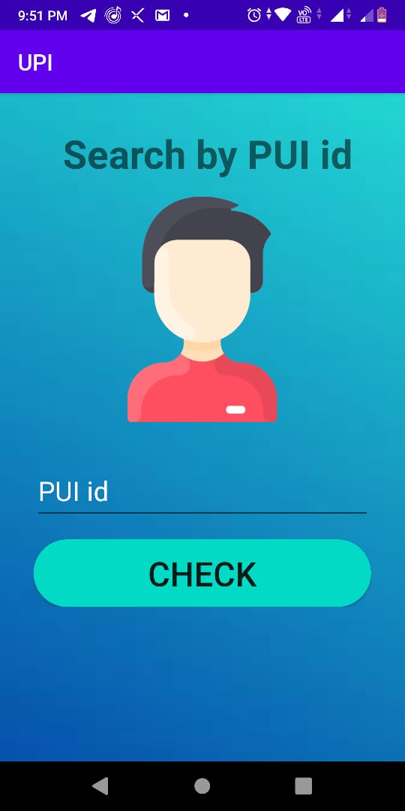

Slide 8
Basic Android app functionality
1) Splash activity screen:
- Whenever we open this app firstly Welcome activity reflect on the Smartphone screen

Slide 9
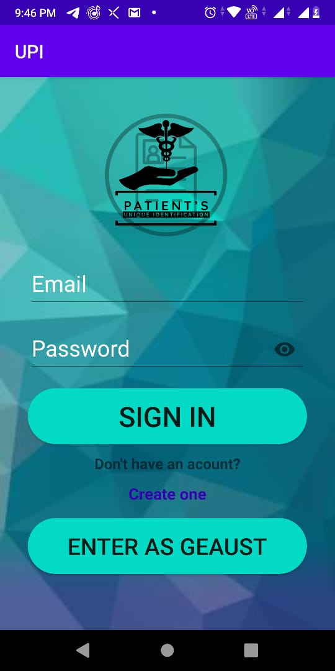
Basic Android app functionality
2) Sign in activity:
- Through Sign in page Patients and Doctor can
Login into their account.
In this page we provide sign up facility.

Slide 10
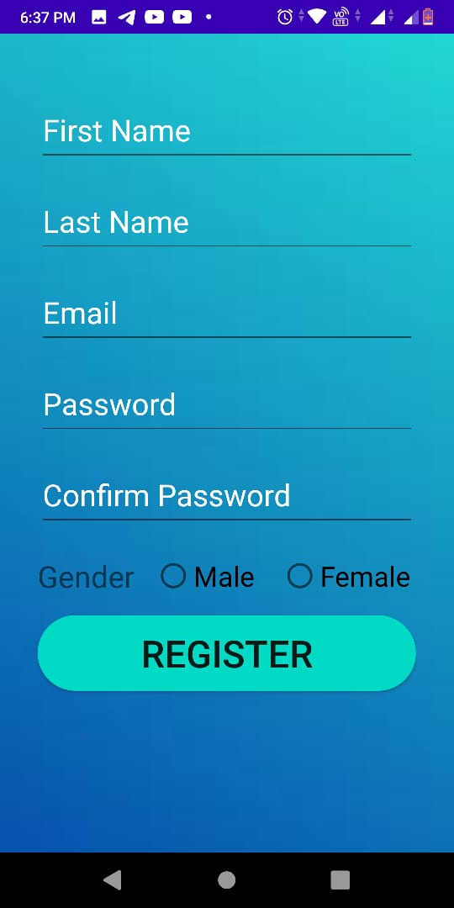
Basic Android app functionality
3) Sign Up activity:
Through Sign Up activity user patient can create a new account with basic information like name, Email-id, Phone no. etc.
Notes:
Photo by Sean Pollock on Unsplash

Slide 11
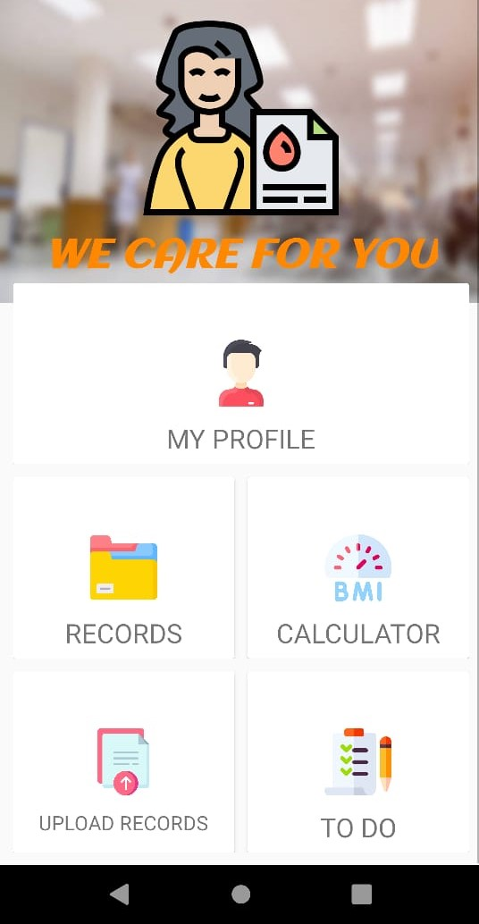
Basic Android app functionality
4) Dashboard activity:
Through Dashboard activity a patient can access different activity like:-
Can see their profile
Upload their reports.
Use BMI Calculator.
See their old reports.
A todo reminder.

Slide 12
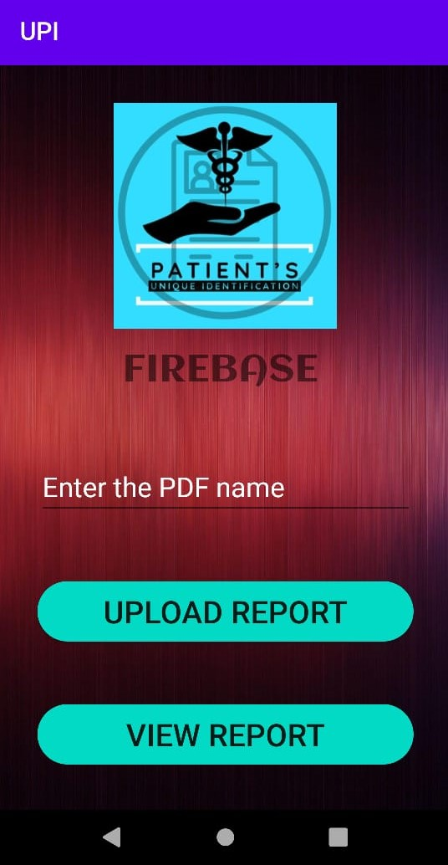
Basic Android app functionality
6) Upload Report activity:
Through Upload Report Activity patients can upload their reports to a server so that it can be access in future.
It will access the user phone storage to get the pdf format report.

Slide 13
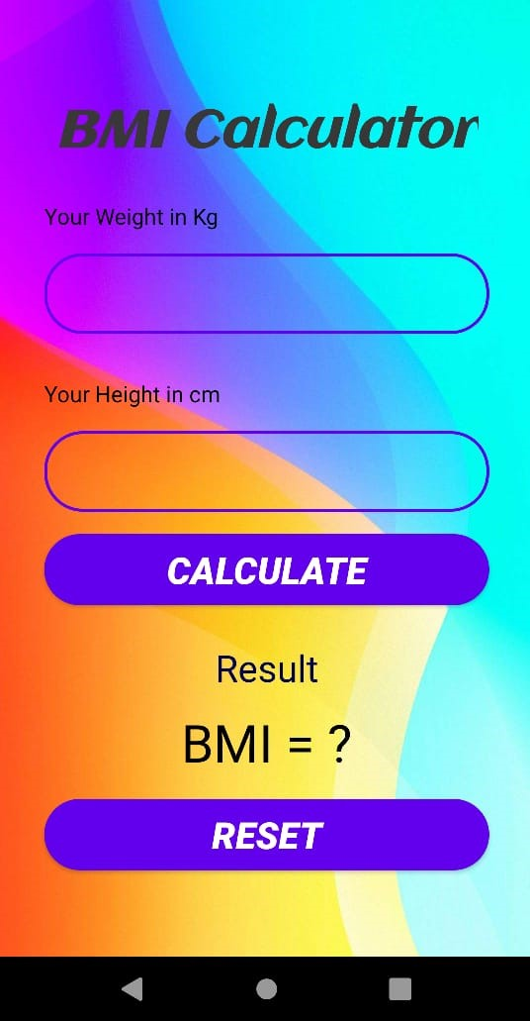
Basic Android app functionality
7)BMI activity:
Through BMI activity a patient can calculate their body mass index.
For that patient has to enter their weight (in kg) and height (in cm).
It has a reset button feature also.

Slide 14
Basic Android app functionality
9) Profile activity:
Through Profile activity a patient can view their details
There is a feature of uploading profile photo.
There is a feature of sign out through the portal.
Edit their profile feature is available their.
Notes:
Photo by Sean Pollock on Unsplash

Slide 15
Basic Android app functionality
8)PUI id activity:
Through this activity any one can search for a person basic detail just by entering PUI id.
PUI id is unique for every patient

Slide 16
Unique’s Patients Identification
Website Portal

Slide 17
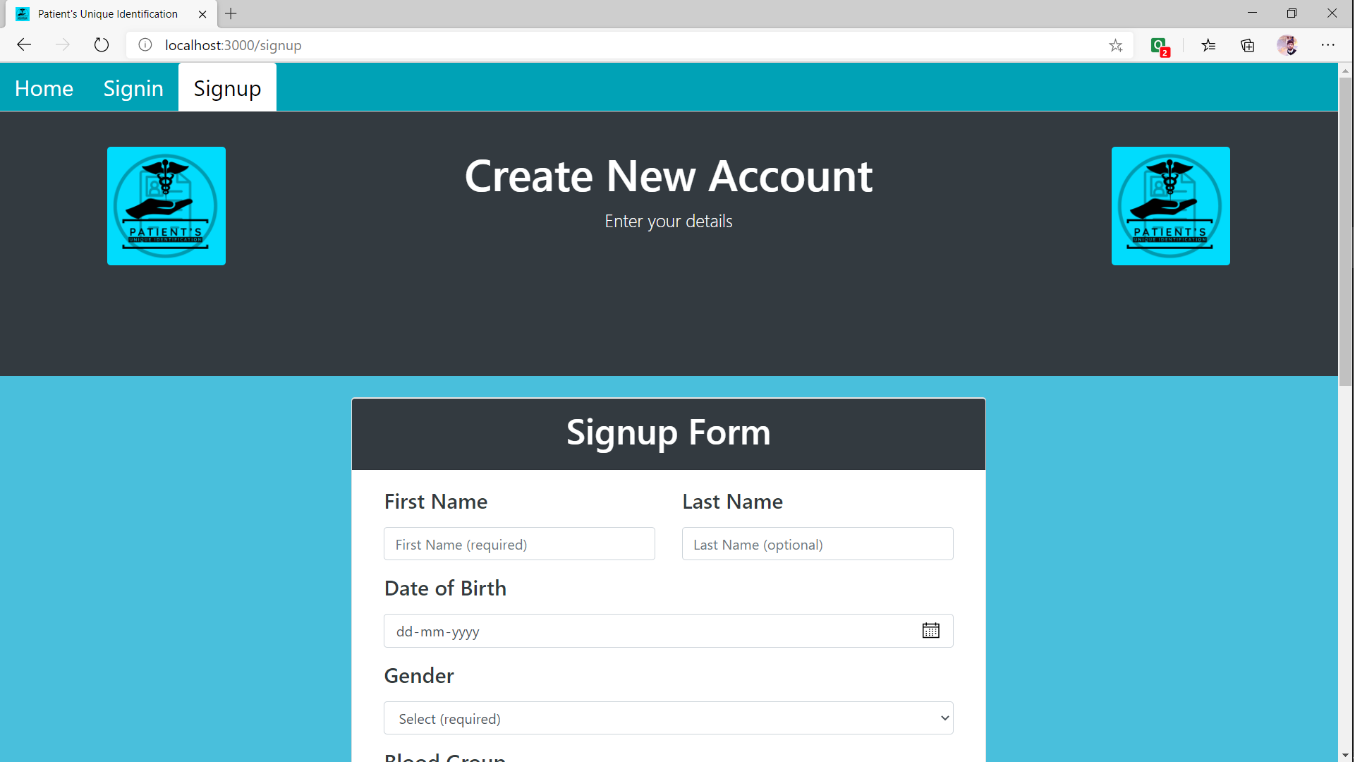

Slide 18
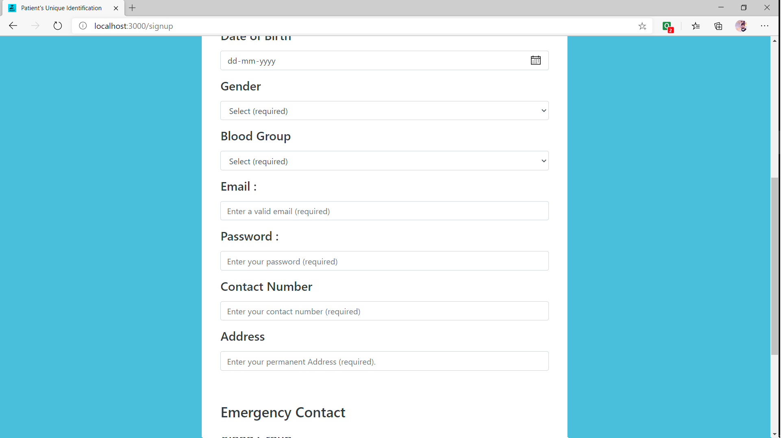

Slide 19
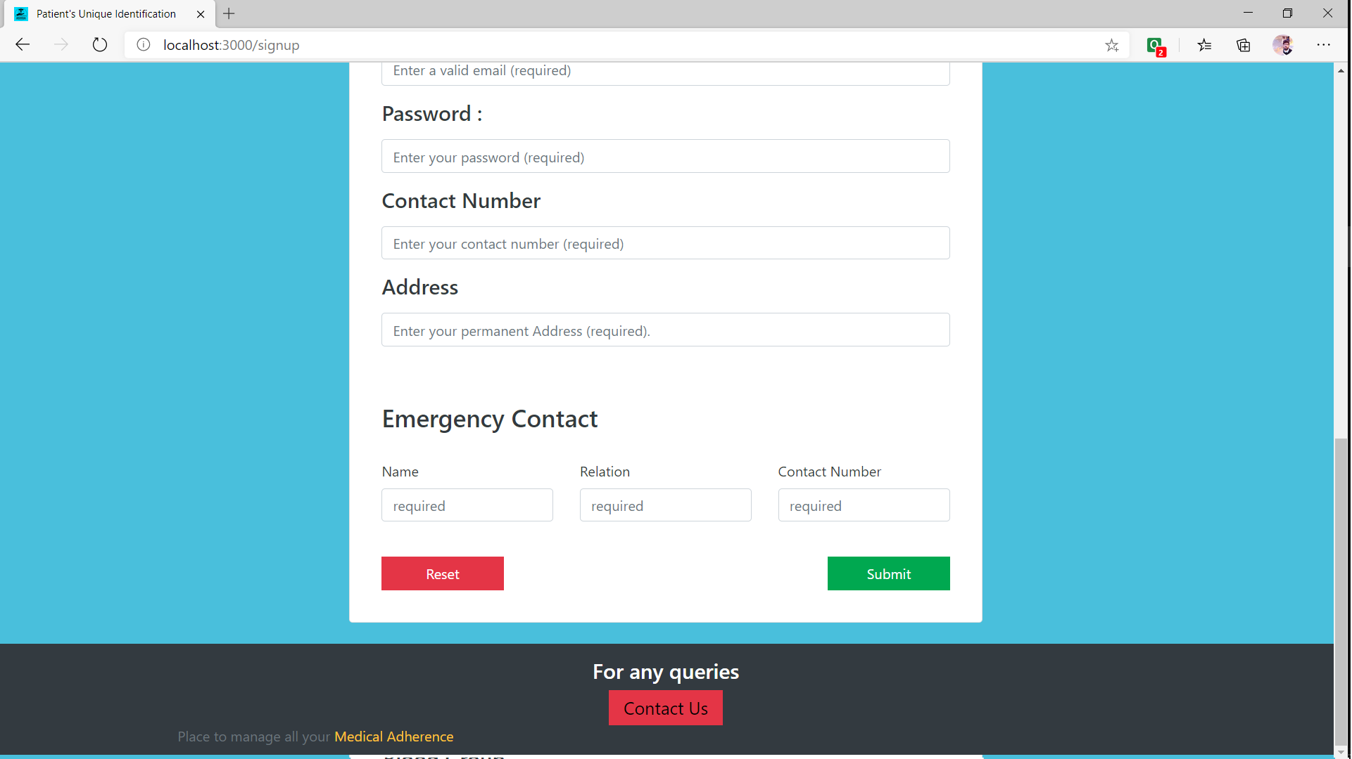

Slide 20
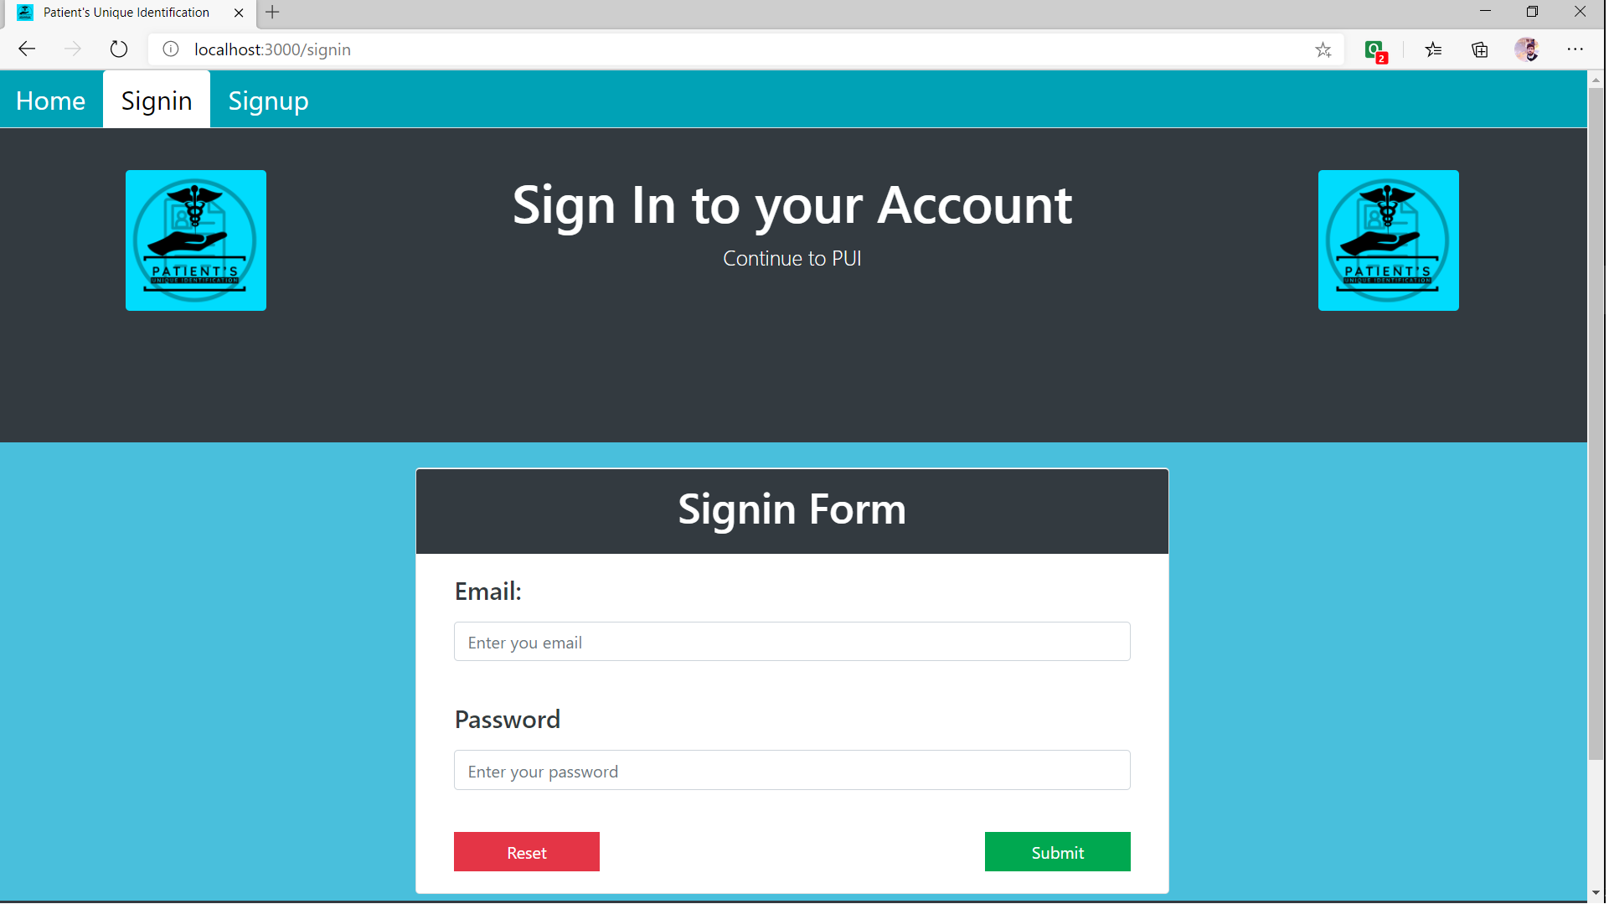

Slide 21
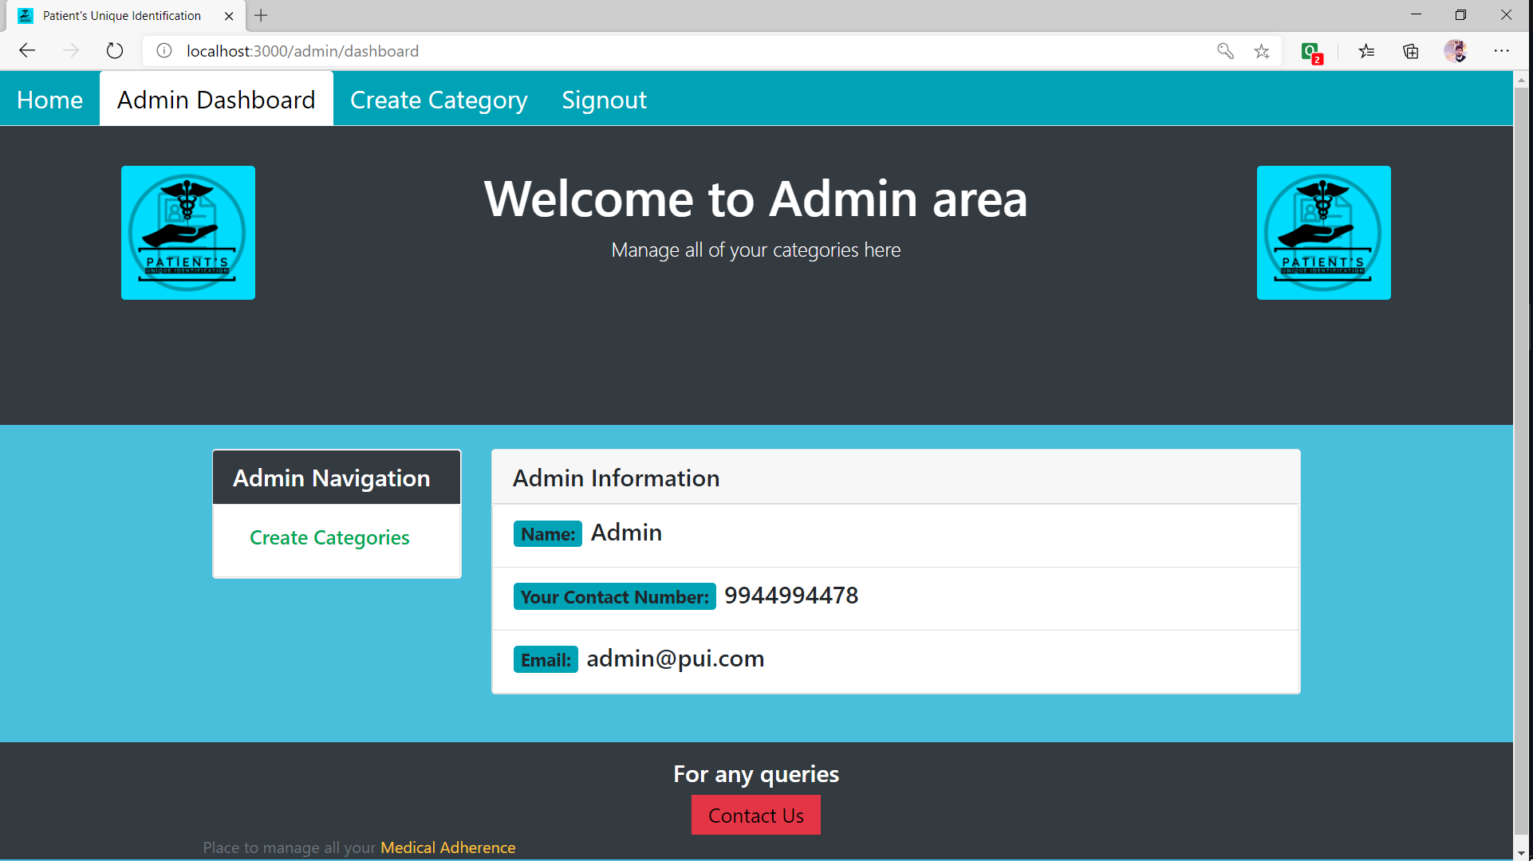

Slide 22
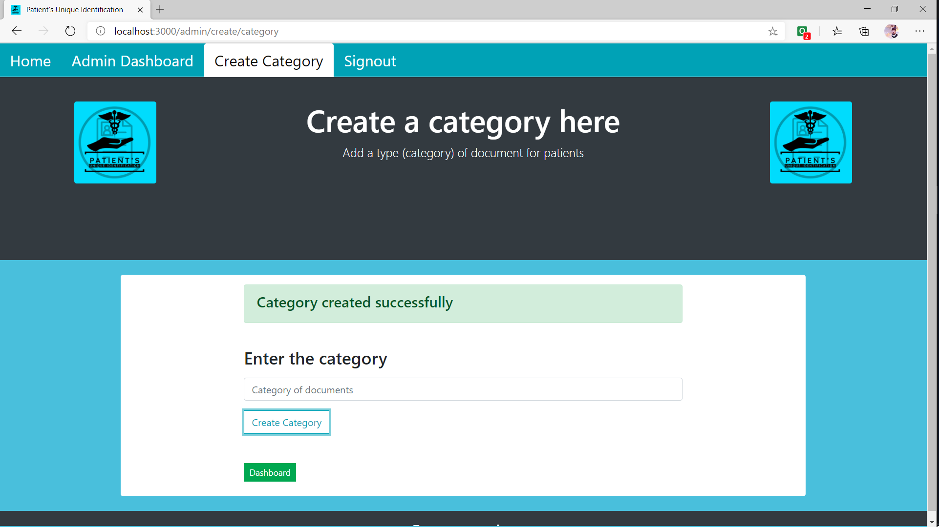

Slide 23
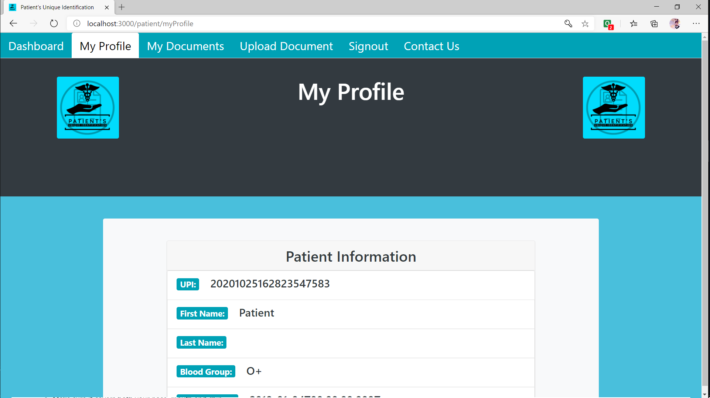

Slide 24
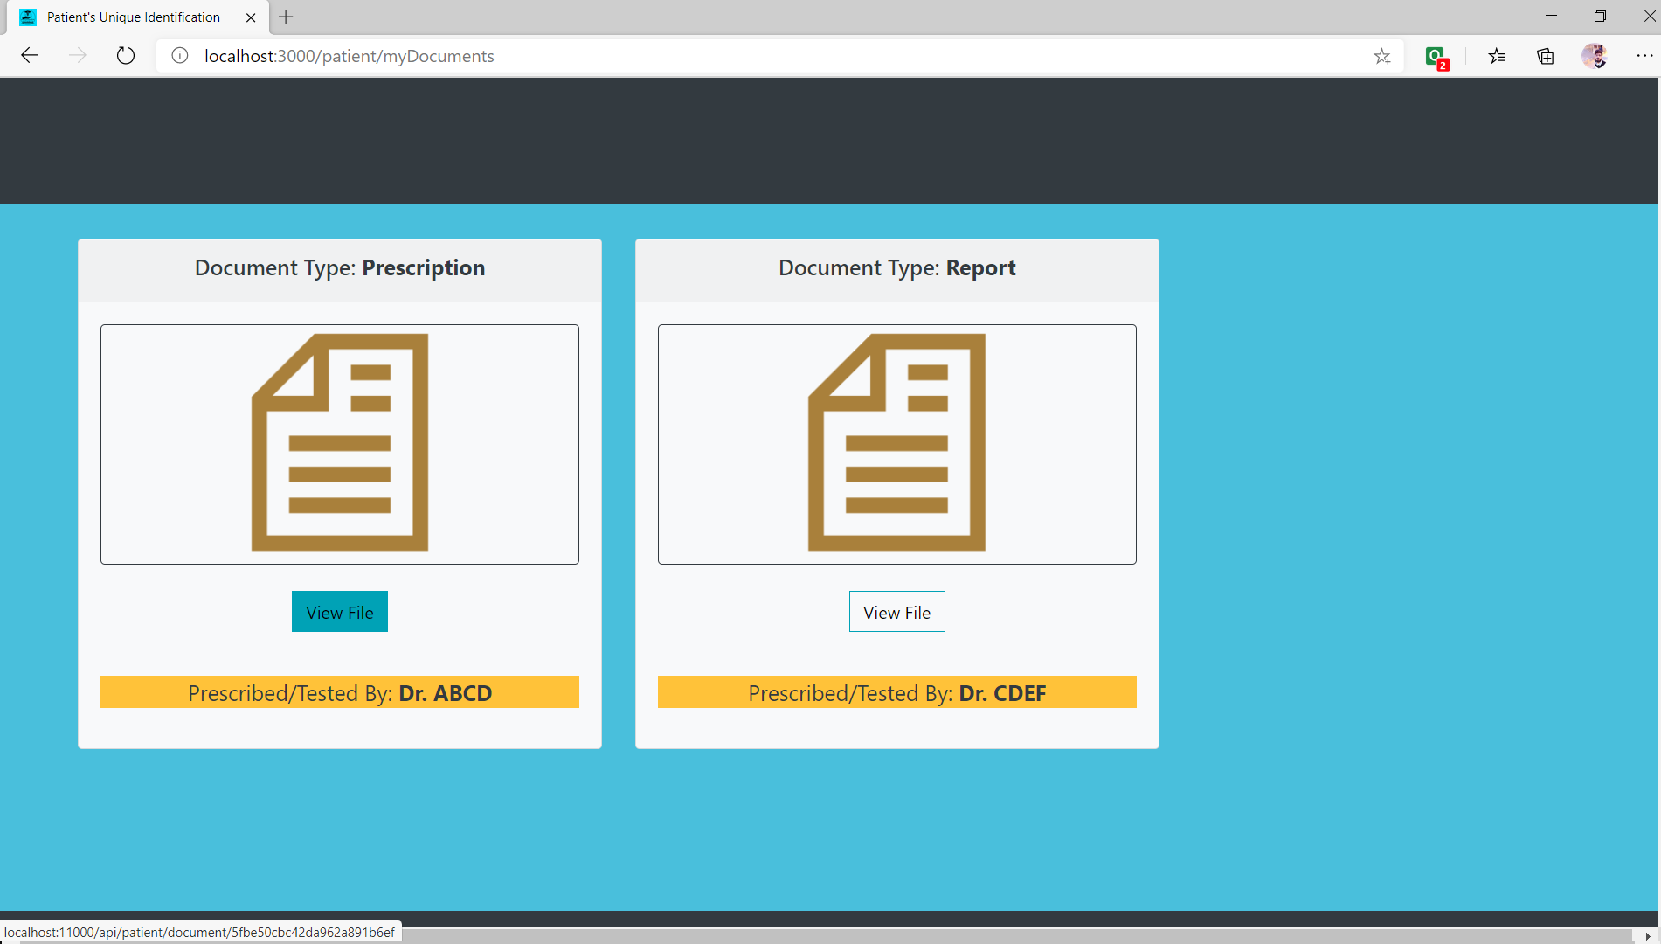

Slide 25
Conclusion
Patient’s Unique Identification app will help patients in many different ways:-
It will keep all the old records of a patients.
In case of emergency one can easily get all the basic information about the patient.
Patient can easily calculate their body mass index.
It will help the patients to get free from thick collection of their old reports.

Slide 26
Thank You

